Slide 1

Data Cleaning and Exploration

Slide 2

OUTLINE
You are given a dataset containing customer feedback for an online retail store. The dataset includes the following columns: Customer_ID, Feedback_Date, Product_ID, Rating, and Comments. Your goal is to prepare this dataset for further analysis by performing data cleaning and exploration.

Slide 3

OBJECTIVE
Clean the dataset by addressing missing values, correcting data types, and processing the text data. Explore the dataset to uncover patterns and insights related to customer feedback.

Slide 4
No.Of Libraries Used:
In this project we have use number of popular libraries of all of them are listed below
Pandas:
Pandas is a powerful Python library designed for data manipulation and analysis, providing flexible data structures like DataFrames and Series. It offers tools for data cleaning, transformation, and statistical analysis.
Numpy:
NumPy is a fundamental Python library for numerical computing, providing support for large, multi-dimensional arrays and matrices, along with a collection of mathematical functions to operate on them.
Matplotlib:
Matplotlib is a comprehensive open-source plotting library for Python that enables users to create static, interactive, and animated visualizations. It provides a flexible framework for generating a wide variety of plots and charts, such as line graphs, bar charts, histograms, scatter plots, and more.
NLTK:
NLTK (Natural Language Toolkit) is a powerful open-source library in Python for natural language processing (NLP). It provides easy-to-use interfaces and tools for tasks such as tokenization, part-of-speech tagging, stemming, lemmatization, parsing, and text classification.
Seaborn:
Seaborn is a Python data visualization library based on Matplotlib that provides a high-level interface for drawing attractive and informative statistical graphics. It simplifies the process of creating complex visualizations.

Slide 5
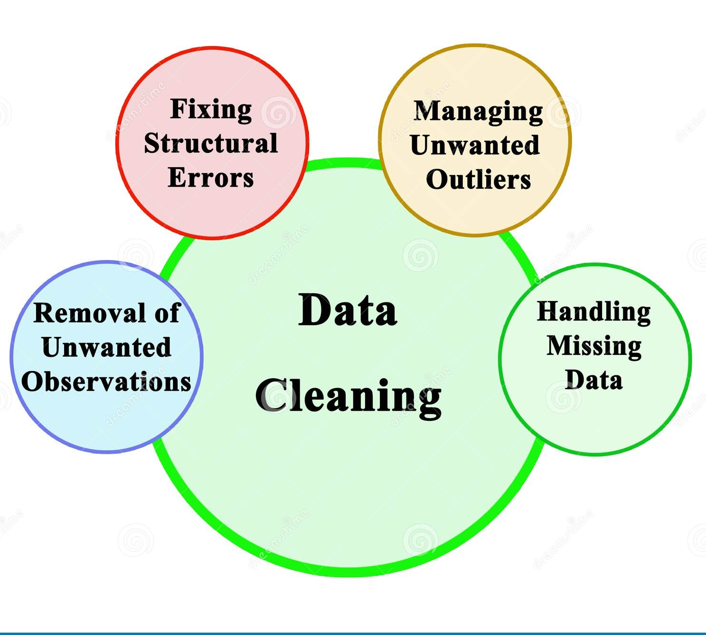
Steps to accomplish this task:

Slide 6
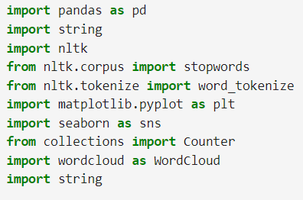
Import the Necessary Libraries
Start by importing libraries such as Pandas to read your dataset into a dataframe and data manipulation, Numpy for mathematical execution, Matplotlib and Seaborn for Graphical representation such graph and trend chats and NLTK for natural language processing and to provide user easy to use interface. To import library we “import” command.
Syntax: Import pandas as pd

Slide 7
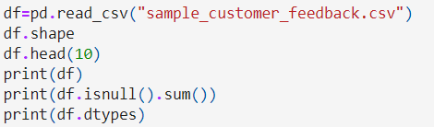
Load The Csv file and Check the Missing Values
Load the csv file to the pandas data frame and show some the rows to understand the content inside the csv file and check the null value in the file and also show the data type of every coloum
To load csv file
Syntax:df=pd.read_csv(“sample_customer_feedback.csv”)
To show some content of csv file
Syntax:df.head( )
To check null values
Syntax: print(df.isnull( ).sum( ))

Slide 8
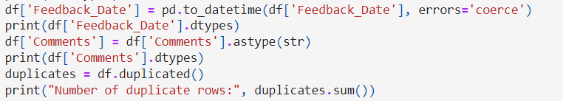
Ensure that Feedback Date is in datetime format and check the number of Duplicate rows
Convert the feedback date into date time format using pd.todatetime and convert the comment to string data type and check the number of duplicate rows
Convert feedback to date time format
Syntax: pd.datetime( )
Convert Comment to string data Type
Syntax: df[‘Comment’].astype(str)
Check the number of duplicate rows
Syntax:df.duplicated( )

Slide 9
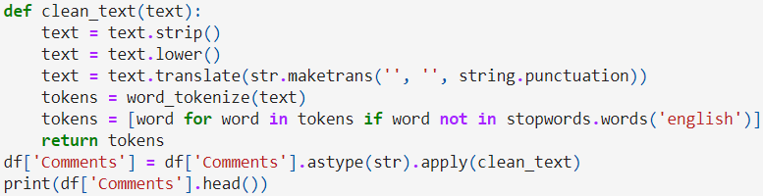
Text Processing
Clean the Comments column by Remove any extra whitespace. Convert text to lowercase. Remove punctuation. Remove any stop words. Tokenize the comments split into individual words. For this create a new function which will represent by def in python code and for these task we use NLTK libray which we have imported early.
For Text strip, Lowercase, Punctution and Tokenize words
Syntax: text.strip
Syntax: text.lower
Syntax: text.translate(str.maketrans(“,”,string.puncation))

Slide 10
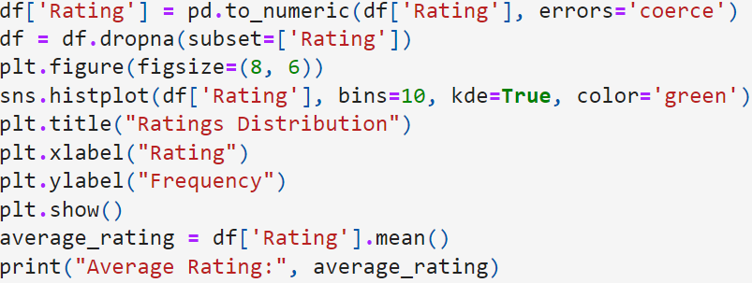
Ratings Distribution
For rating distribution we will matplotlib library to show a graphical representation on rating coloum.
Convert Ratings to Numeric:
Syntax: pd.to_numeric(df['Rating'], errors='coerce')
Remove Missing Ratings:
Syntax: df.dropna(subset=['Rating'])
Set Up the Plot:
Syntax: plt.figure(figsize=(8, 6))
Syntax: sns.histplot(df['Rating'], bins=10, kde=True, color='green')

Slide 11
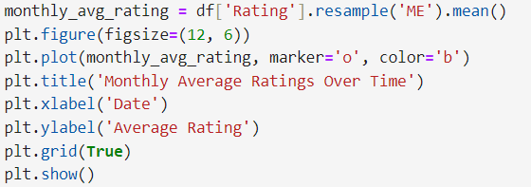
Calculate Monthly Average Ratings AnD Set Up the Plot
In part we are using pandas for calulating montly average rating and the matplotlib for showing the rating trend
Calculate Monthly Average Ratings
Syntax = df['Rating'].resample('ME').mean()
Set Up the Plot:
Syntax: plt.figure(figsize=(12, 6))
Add Date,Titles and Labels:
Syntax: plt.plot(monthly_avg_rating, marker='o', color='b')
Syntax: plt.title('Monthly Average Ratings Over Time')
Syntax: plt.xlabel('Date')
Syntax: plt.ylabel('Average Rating')

Slide 12

ConClusion
This code effectively cleans and transforms customer feedback data, visualizes rating distributions, and tracks changes in customer satisfaction over time. By exporting the results, it allows for additional analysis or reporting. The code is a useful tool for businesses looking to gain insights into customer feedback trends and enhance their understanding of customer satisfaction.

